Slide 1

ATLIQ Mart
Sales/Promotion Analysis-FMCG Domain

Slide 2
Problem Statement
ATLIQ Mart is a retail giant with over 50 supermarkets in the southern region of India.
All 50 stores ran a massive promotion during Diwali 2023 & Sankranti 2024.
This is the festive time in India.
The primary objective is to identify the promotions that performed well and those that did not ,enabling decision-making for future promotional strategies.

Slide 3
Power BI Dashboard

Slide 4
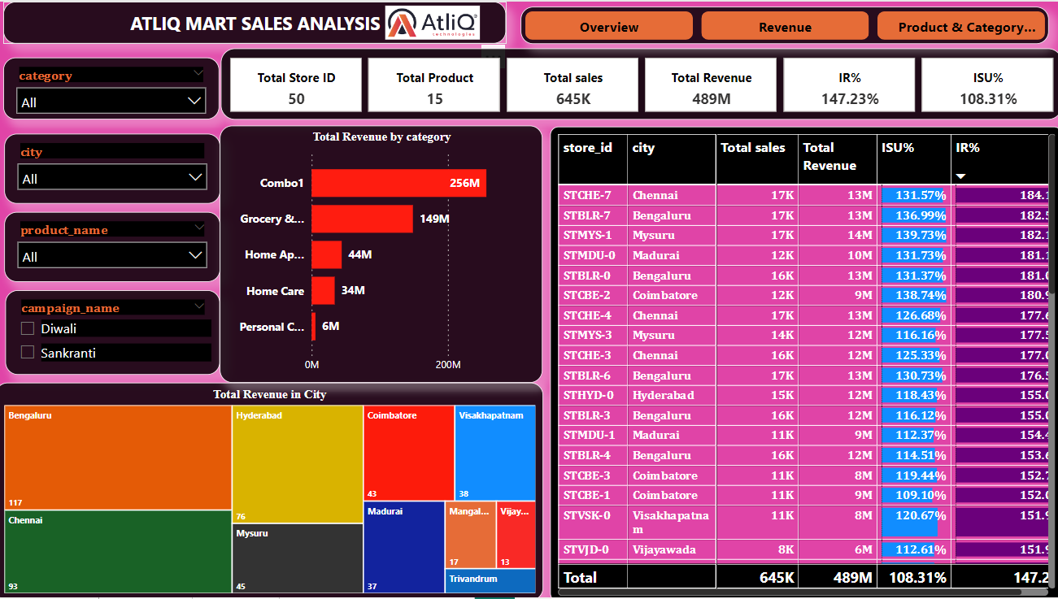

Slide 5
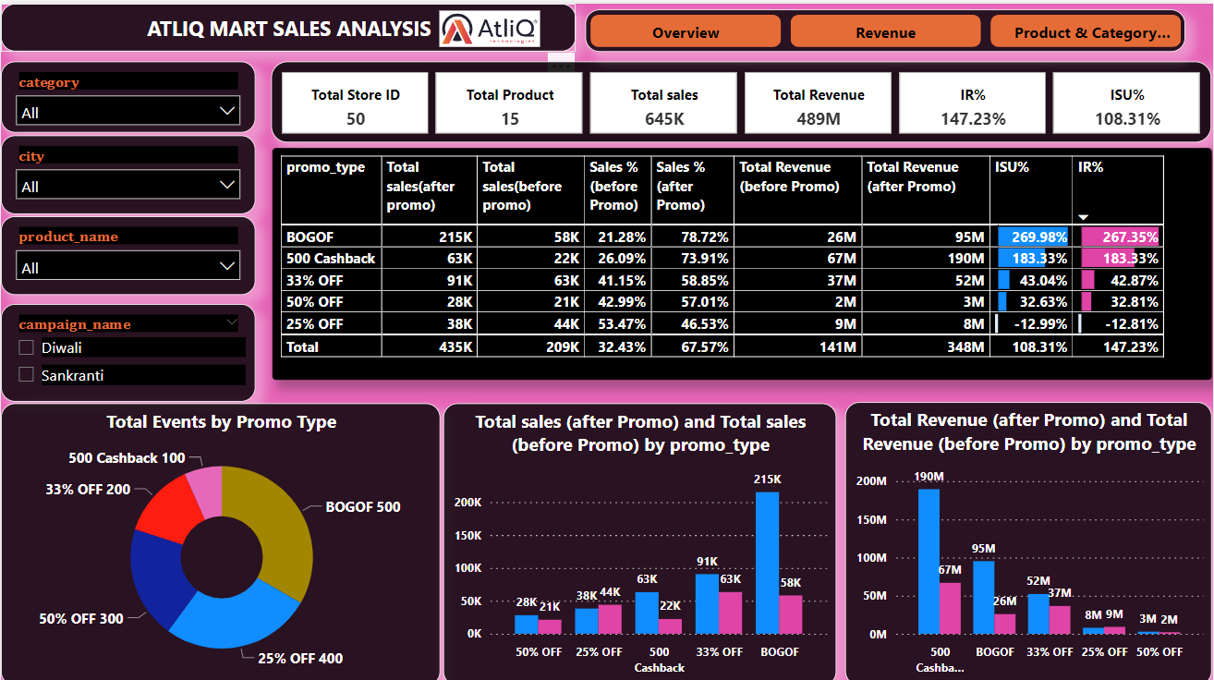

Slide 6
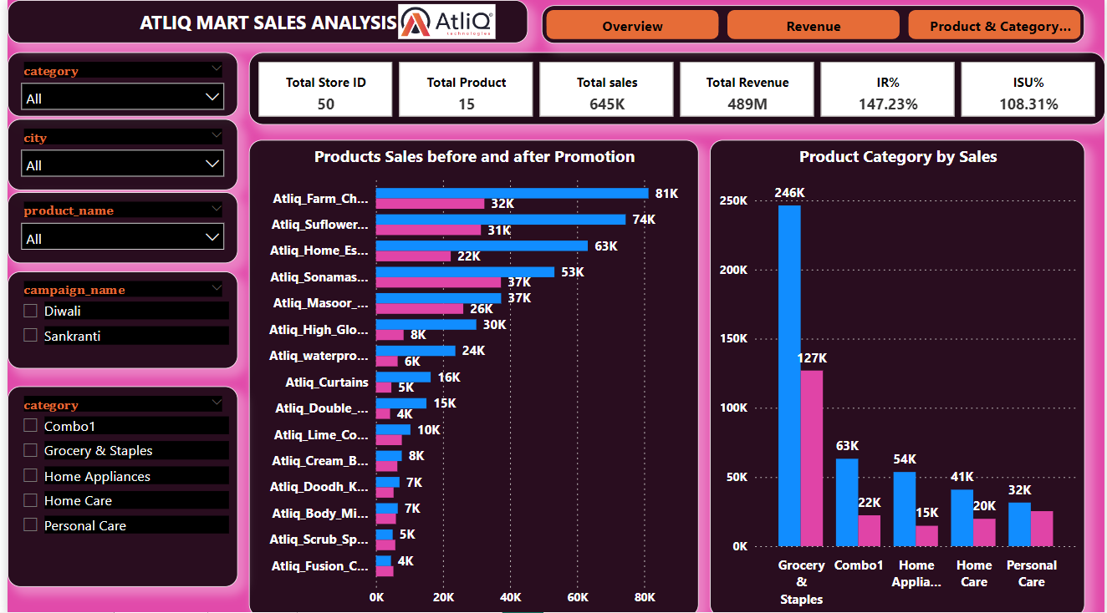

Slide 7
Ad-Hoc Business Requests

Slide 8

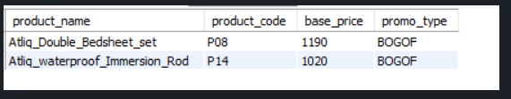
1. Provide a list of products with a base price greater than 500 and that is featured in promo type of’BOGOF’9Buy one get one free).This information will help us identify high level products that are currently being heavily discounted ,which can be useful for evaluating our pricing and promotion strategies.

Slide 9
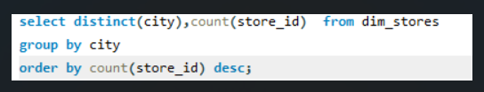
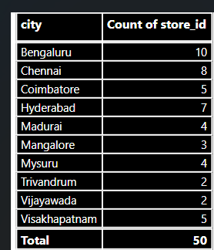
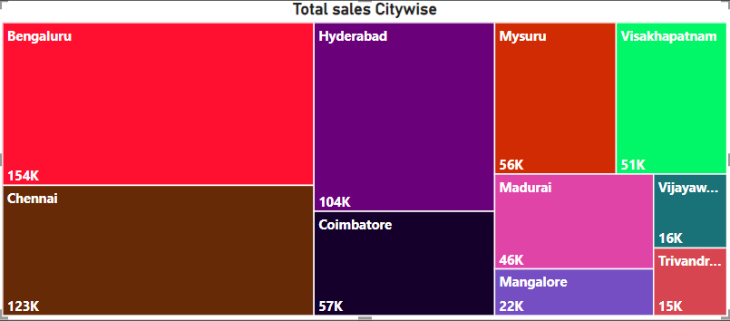
2. Generate a report that provides an overview of the number of stores in each city. The results will be sorted in descending order of store counts, allowing us to identify the cities with the highest store presence. The report includes two essential fields: city and store count, which will assist in optimizing our retail operations.
Bengaluru, Chennai and Hyderabad, the top three cities, collectively make up 50% of the total stores in the southern region of India.

Slide 10
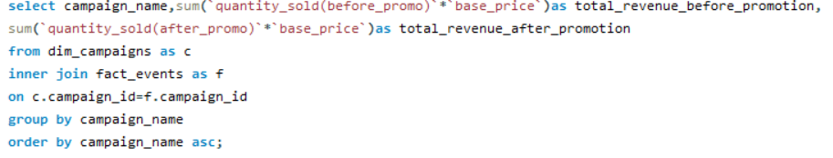

3.Generate a report that displays each campaign along with the total revenue generated before and after campaigns. The report includes three key fields: campaign name, total revenue(before_promotion), total revenue(after_promotion).This report should help in evaluating the financial impact of our promotional campaigns.

Slide 11
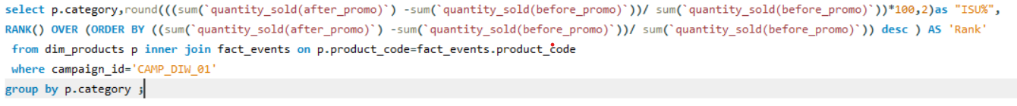
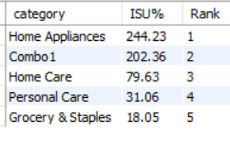
4. Produce a report that calculates the Incremental Sold Quantity(ISU%)for each category during Diwali campaign. Additionally, provide rankings for the categories based on their ISU%.

Slide 12
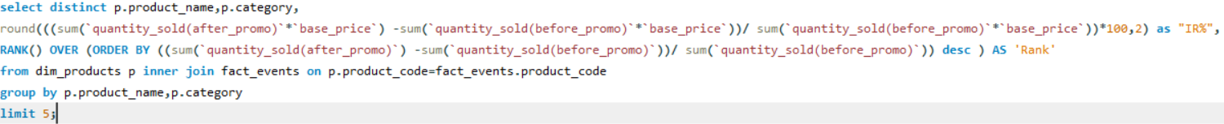
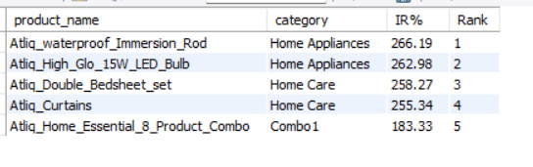
5.Create a report featuring the Top 5products,ranked by Incremental Revenue percentage(IR%),across all campaigns. The report will provide essential information including product name, category and IR%. This analysis helps identify the most successful products in terms of incremental revenue across our campaigns, assisting in product optimization.

Slide 13
Thank You

